Slide 1

Project “one” presents: Project

Slide 2
Hacker
Hacker – A person who circumvents security and breaks into a network, computer, file, etc.

Slide 3
Cypher
A hidden code, or secret code.
Encode

Slide 4
NEO
Neo: is an anagram for “one”. In computer science 1 is the on button, as zero is his contrast.
ONE stand for true- the true one
“Neo” means new.

Slide 5
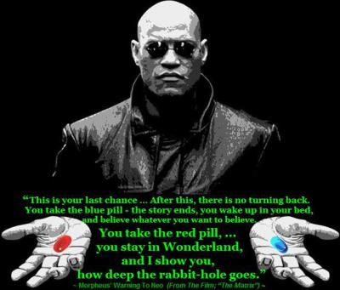

Slide 6
Sentinel
a special value in the context of an algorithm which uses its presence as a condition of termination, typically in a loop or recursive algorithm.

Slide 7
Cookies
Cookies: On his first visit to the Oracle, Neo receives a cookie from the oracle.
A cookie in CS is a file that is saved on the computer after visting a website. The cookie is proof that Neo went to visit the Oracle.

Slide 8
Database
A database is a collection of information that is organized so that it can easily be accessed, managed, and updated.

Slide 9
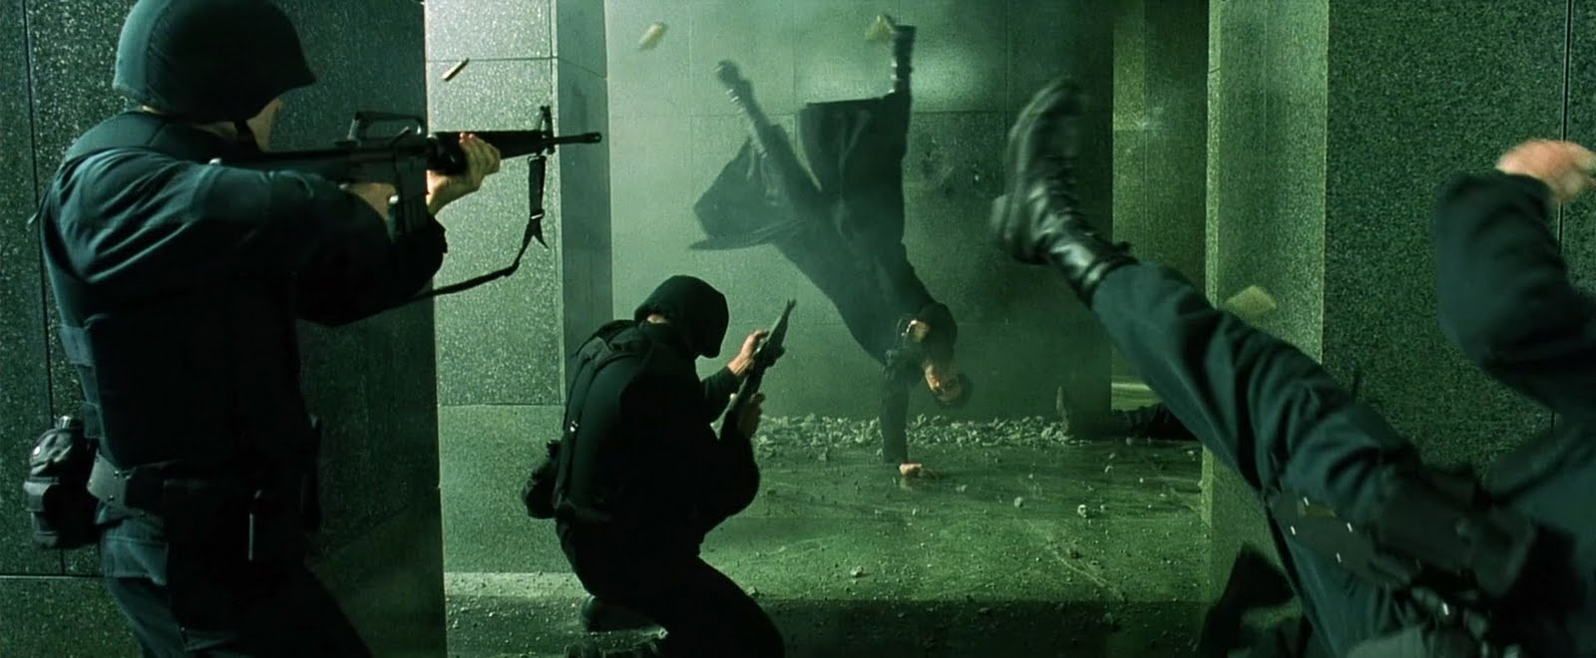

Slide 10
DECODE
Decode – To translate data or message form a code into the original language or form

Slide 11
ACCESS CODE
A code of numbers or letters that is entered into a computer network so as to access a particular service.
+

Slide 12
Trace Program
A program that finds the origin of when something began or where it came from.

Slide 13
Can you see it?!

Slide 14
Matrix
a neural interactive simulation, a sea of computing resources that can be visualized by the user.

Slide 15
Artificial Intelligente
the intelligence exhibited by machines or software computers and computer software that are capable of intelligent behavior.

Slide 16
The Core
The central console of the hovercraft which is like the terminal application in computers.

Slide 17


